Slide 1
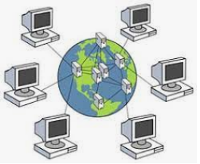
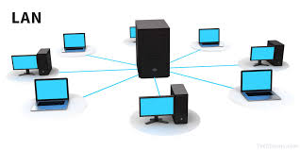
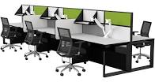
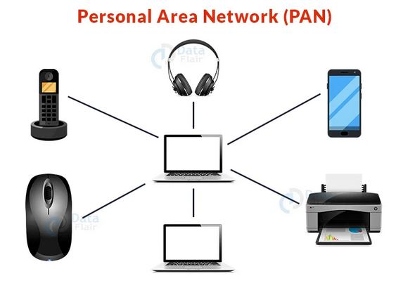
About Networks
Networks
Local
Area Networks
Personal Area Networks
About
Peter J Faulks
Networks
Wide Area Networks
Municipal Area Networks
Computer Hardware

Slide 2
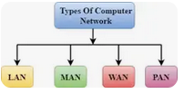
Help Page
1
Help Page
Network History
LAN (Local Area Network)
Networks
WAN(Wide Area Network)
Tree Network
Mesh Network
PAN(Personal Area Network)
MAN(Metropolitan Area Network)
Marconi Morse Code
My Screen Template
This takes you to the help page
This takes you to the previous slide
This takes you to the home page
This takes you to the next slide page
This takes you to the last page
Peter Faulks About Networks. Slide 2

Slide 3
What is the main difference between Wired and Wireless networks?
A wired network uses cables like Ethernet or USB connectors to connect devices, such as laptop or desktop computers, printers, speakers to the items like computers in a network.
A wireless network allows devices to stay connected to the network do not need to be tethered to cables, they connect using frequencies set to a main server
Peter Faulks About Networks. Slide 3

Slide 4
What is a Network?
A network consists of two or more computers that are linked in order to share resources (such as printers and CDs), exchange files, or allow electronic communications. The computers on a network may be linked through cables, telephone lines, radio waves, satellites, or infrared light beams.
A computer network is a set of computers sharing resources located on
or provided by network nodes.
The computers use common communication protocols over digital interconnections to communicate with each other, protected by passwords and connection protocols using wi-fi.
A network node can be defined as the connection point among network devices such as routers, printers, or switches that can receive and send data from one endpoint to the other.
https://theapplemuseum.org/html/main/x-mac-128k.html
https://www.google.com/search?client=firefox-b-e&q=network+nodes%00
Peter Faulks About Networks. Slide 4

Slide 5
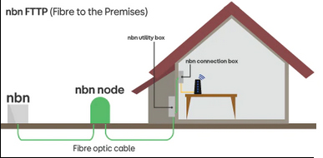
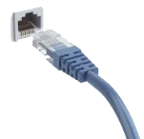
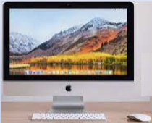
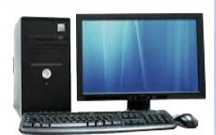
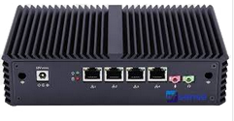
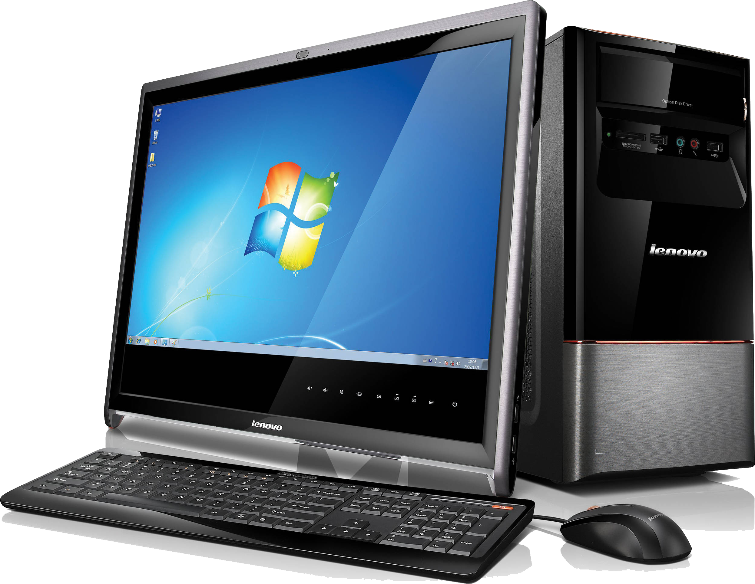
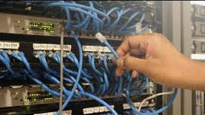
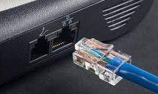
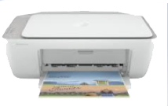
What is a wireless network
From ISP (NBN)
Computer 2
Main Server
Computer 1
Modem
Computer 3
Router
All share printer
Peter Faulks About Networks. Slide 5

Slide 6
What is a network
and why do we use them?
We use them to help in communication, finding information and sharing our work
We can connect printers, computers, Televisions, iPads, Mobile Phones like iPhones and Android devices and media players.
File sharing: Networking of computers helps the network users to share data files. (Text, Images, Movies etc.)
Hardware sharing: Users can share devices such as printers, scanners, CD-ROM drives, hard drives etc. Without computer networks, device sharing is not possible.
Application sharing: Applications can be shared over the network, and this allows to implement client/server applications
User communication: Networks allow users to communicate using e-mail, newsgroups, and video conferencing etc.
Peter Faulks About Networks. Slide 6

Slide 7
Networks Network Types
Four Main Network Types
Name four main network types (topologies)
but more variations exist as well
There are 4 main networks which are :
LAN – Local Area Network which are a few computers linked to 1 or 2 printers with a shared internet connection,
MAN - Metropolitan Area Networks which are networks that cover a town or city and lastly the world
WAN – Wide Area Network which are networks that cover any geographical area.
PAN – Personal Area Networks which is a convenient 1 person network, wired printers modem, speakers
Peter Faulks About Networks. Slide 7

Slide 8
LAN Ethernet Network
LAN (Local Area Network)
Local Area Network is a group of computers connected to each other in a small area such as building, office.
LAN is used for connecting two or more personal computers through a communication medium such as twisted pair, Ethernet, coaxial cable, or USB.
It is less costly as it is built with inexpensive hardware such as hubs, network adapters, and Ethernet cables.
The data is transferred at an extremely fast rate
Modem
Server
https://www.javatpoint.com/types-of-computer-network
Peter Faulks About Networks. Slide 8

Slide 9
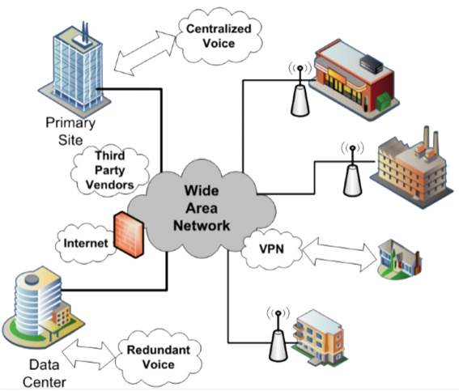
Wide Area Network Remote networking
A WAN extends over a large geographical area and connects individual users or multiple LANs. The Internet can be considered a WAN. Large organizations use WANs to connect their various sites, remote employees, suppliers, and data centers so they can run applications and access necessary data.
Physical connectivity in WANs can be achieved by leased lines, cellular connections, satellite
links, and other means.
WANs are designed to provide network connectivity over long distances. They are usually made up of several connected LANs. An organization that sets up its own
WAN will almost always rely on network infrastructure that is outside their control: for example, a company with
an office in Paris and an office in New York will have to send data between these offices over undersea cables that cross the Atlantic Ocean.
Usually a WAN will include multiple routers and switches.
Peter Faulks About Networks. Slide 9

Slide 10
PAN Personal Area Network Home Network
A personal area network is a computer network for interconnecting electronic devices within an individual person's workspace. A PAN provides data transmission among devices such as computers, smartphones, tablets and personal digital assistants. Usually by wire, cable printer and USB chargers or Bluetooth.
Advantages of PAN:
PAN networks are reasonably safe and secure.
It only provides a short-range solution of up to 10 metres.
Strictly confined to a small specific area
Disadvantages of PAN:
It may make a poor connection to other networks using the same radio frequencies.
There are distance restrictions.
https://data-flair.training/blogs/types-of-computer-networks/
Peter Faulks About Networks. Slide 10

Slide 11
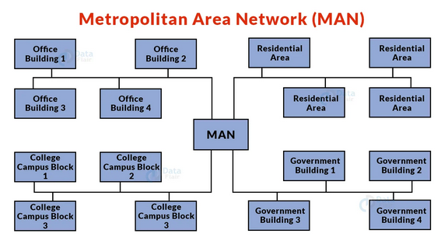
MAN Metropolitan Area Network Remote Network
A MAN is a network that is larger than a LAN but smaller than a WAN.
This is a sort of computer network that connects computers separated by geographical distances via a common communication channel across a city, town, or metropolitan region.
Example: Networking in towns, cities, a single large city etc.
Advantages of MAN: It enables rapid communication by utilising high-speed carriers such as fibre optic cables.
It offers good support for a large network and increased access to WANs.
The dual bus in a MAN network allows data to be sent in both directions at the same time.
A MAN network often comprises portions of a city or a whole city.
Disadvantages of MAN:
More cable is required to make a MAN connection from one location to another.
It is difficult to safeguard a MAN network against hackers.
https://data-flair.training/blogs/types-of-computer-networks/
Peter Faulks About Networks. Slide 11

Slide 12
Network protocols into you home
Protocols include:
Transmission Control Protocol (TCP)
Internet Protocol (IP)
User Datagram Protocol (UDP)
Post office Protocol (POP)
Simple mail transport Protocol (SMTP)
File Transfer Protocol (FTP)
Hyper Text Transfer Protocol (HTTP)
Hyper Text Transfer Protocol Secure (HTTPS)
Wi-Fi is connected by (Nodes) two options Phone Line or Mobile
Phone or using fibre optical cable
ISP to Street
To Box or Modem
NBN is National Broadband Network
These packets can then be sent by devices like switches and routers to the designated targets. Ethernet cable, (ADSL) etc.)
Asymmetric Digital subscriber line
Peter Faulks About Networks. Slide 12

Slide 13
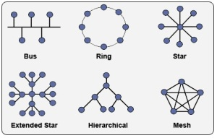
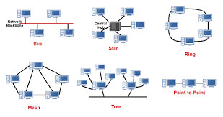
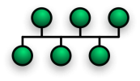
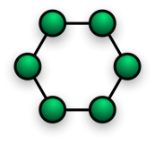
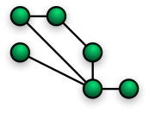
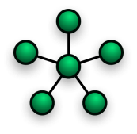
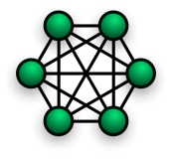
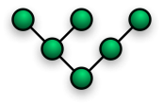
Other Networks
A Network is a collection of computers and devices connected together that allow communications between the users and let them share resources with each other.
Network topology is the layout of the interconnections of the elements of a computer network.
Network Topology types:
Ring,
Mesh,
Star,
Fully Connected,
Line,
Tree
Bus
Bus
Ring
Mesh
Star
Fully Connected
Line
Tree
Peter Faulks About Networks. Slide 13

Slide 14
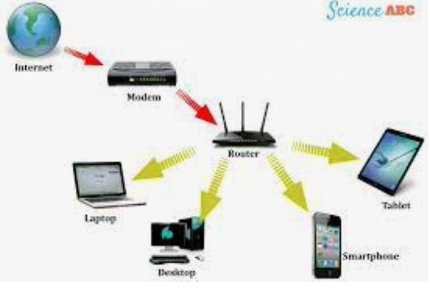
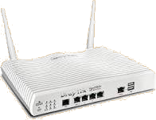
Networks overview
Along with the invention of the Internet in the 1990s, people became interconnected through computer networks that link computers worldwide. There are many popular ways of communication over the internet, using a modem to convert signals this enables communication via email, social networking and instant messaging.
Modem
Peter Faulks About Networks. Slide 14

Slide 15
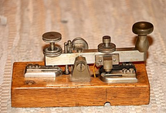
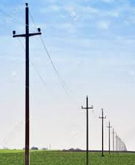
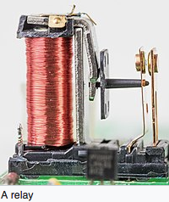
Networks
When did networks begin Morse Code
Radiotelegraphy and aviation. In the 1890s, Morse code began to be used extensively for early radio communication before it was possible to transmit voice. In the late 19th and early 20th centuries, most high-speed international communication used Morse code on telegraph lines, undersea cables, and radio circuits. Morse developed the concept of a single-wire telegraph.
In time, the Morse code that he developed would become the primary language of telegraphy in the world.
Cooke and Wheatstone formed a partnership and patented the electrical telegraph in May 1837, and within a short time had provided the Great Western Railway with a 13-mile (21 km) stretch of telegraph. However, within a few years, Cooke and Wheatstone's multiple-wire signaling method would be overtaken by Morse's cheaper method.
Morse encountered the problem of getting a telegraphic signal to carry over more than a few hundred yards of wire. Morse introduced extra circuits or relays at frequent intervals and was soon able to send a message through ten miles (16 km) of wire.
Wire Poles carry signals
Peter Faulks About Networks. Slide 15

Slide 16
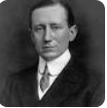
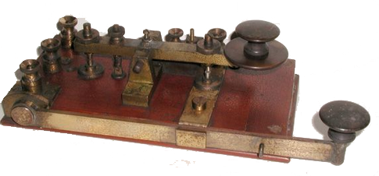
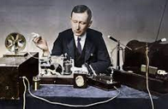
Networks
Marconi spark key used on Titanic
When did networks begin - Marconi
Marconi was convinced that communication among people was possible via wireless radio signalling. In 1895, he began to experiment at his father's home in Pontecchio, where he was soon able to send signals over one and a half miles.
Titanic
The role played by Marconi Co. wireless in maritime rescues raised public awareness of the value of radio and brought fame to Marconi, particularly the sinking of the RMS Titanic on 15 April 1912 RMS Titanic radio operators Jack Phillips and Harold Bride were not employed by the White Star Line but by theMarconi International Marine Communication Company.
https://en.wikipedia.org/wiki/Guglielmo_Marconi
Peter Faulks About Networks. Slide 16

Slide 17
Networks
Marconi & the Titanic
After the sinking of Titanic on 15 April 1912, survivors were rescued by the RMS Carpathia of the Cunard Line. The Carpathia took a total of 17 minutes to both receive and decode the SOS signal sent by the Titanic. There was a distance of 58 miles between the two ships. After this incident, Marconi gained popularity and became more recognised for his contributions to the field of radio and wireless technology
For aircraft The "mayday" procedure word was conceived as a distress call in the early 1920s by Frederick Stanley Mockford, officer-in-charge of radio at Croydon Airport, England. He had been asked to think of a word that would indicate distress and would easily be understood by all pilots and ground staff in an emergency.
S O S Became the universal signal for help. All ships had to keep their radios on at all times.
https://en.wikipedia.org/wiki/Guglielmo_Marconi
Peter Faulks About Networks. Slide 17

Slide 18
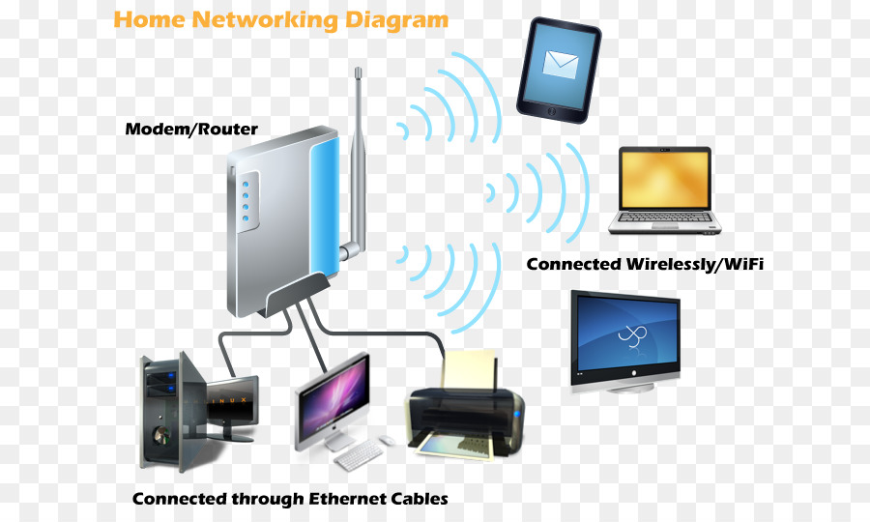
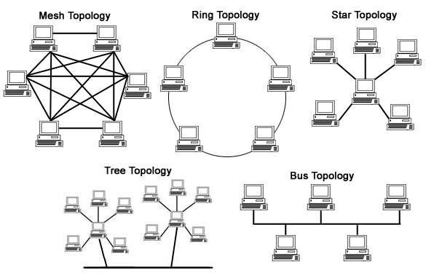
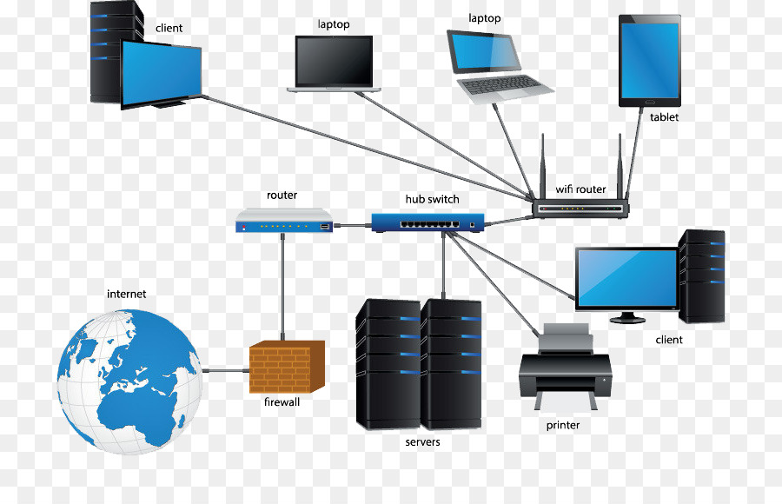
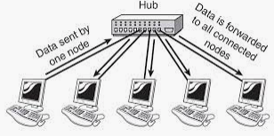
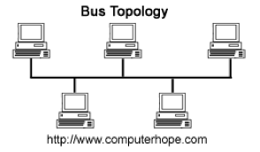
Protecting Networks
Passwords the best password to use
All public networks are less secure than your home network. Even if the websites you visit use encryption, the URLs you visit can be eavesdropped. For this reason, you should not transmit private or sensitive information on a public Wi-Fi network if you can do it elsewhere. If a public network does not require a password, we strongly recommend you do not connect any of your devices to it.
https://www.omnisecu.com/basic-networking/why-we-need-computer-network.php
Peter Faulks About Networks. Slide 18

Slide 19
Networks
Advantages of Network
Advantages of a network
There are more advantages to a network than disadvantages. In fact, many companies
today wouldn't exist without accessing some form of network. Below are the advantages of a network.
1. Share data and information - One of the biggest advantages of a network is sharing data and information between each of the devices on it. In addition, networks allow access to databases and help with collaboration on more complex work.
2. Communication - A network gives all users the ability to quickly communicate with each other using chat, instant messaging, e-mail, and videoconferencing.
3. Share hardware - Hardware devices connected to a network can be shared with all users. Below are a few examples of network hardware that can be shared.
NAS (network-attached storage) can store and access vast amounts of information.
A network printer allows all network users to print to one printer.
More powerful computers, supercomputers, and render farms can perform complex tasks that would take a normal, single computer longer to complete.
4. Share software - With the proper software license, software can also be shared.
5. Transferring money - Being connected to a secure network allows a person or business to digitally transfer money between banks and users. For example, a network could allow a company to not only manage employees' payroll, but also transfer their pay to the employee's bank account.
https://www.computerhope.com/jargon/n/network.htm
Peter Faulks About Networks. Slide 19

Slide 20
Networks
Disadvantages of Network
Disadvantages of a network
Although there are many advantages to a network (mentioned above), there are some
disadvantages. Below are the disadvantages of a network.
Virus and malware - Networks make sharing information between network users easy. Unfortunately, this also means that viruses and malware have an easier time spreading between computers on a network.
Vulnerabilities - When a network is created, it introduces new methods of accessing the computers remotely, especially if they're connected to the Internet. With these potential new methods of accessing the computer, it can introduce new vulnerabilities to computers, users, and data on a network.
Complexity - Networks are complex, and setting up and managing a network for a business or corporation requires someone with a lot of experience or certification.
https://www.computerhope.com/jargon/n/network.htm
Peter Faulks About Networks. Slide 20

Slide 21
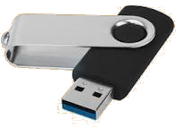
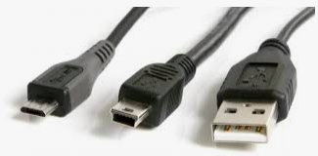
What is a Wired network?
Show how you would set up a Personal Area Network using only cables. (Printer, USB cables, phone cable, )
Connected to a wire or system of wires, as an electronic device connecting computer systems or peripheral devices
Wired computer
to computer
USB Flash drive
plug in
A Wired network?
Usually uses Ethernet cables and for Printers a printer cable
Wired Printer
USB to printer
Peter Faulks About Networks. Slide 21

Slide 22
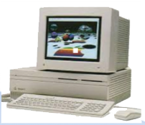
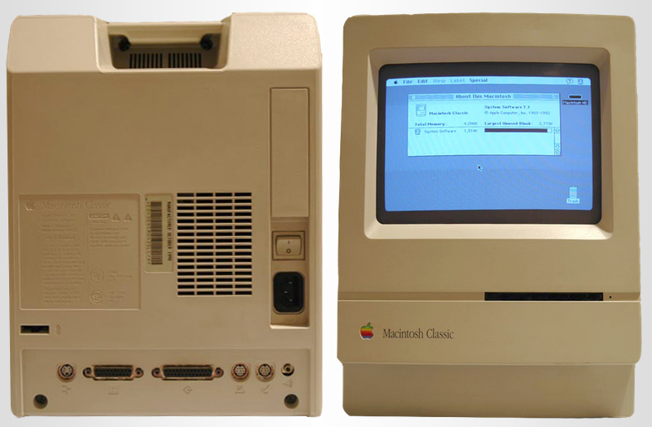
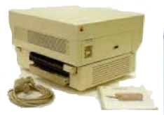
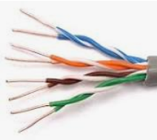
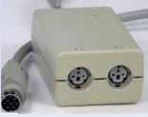
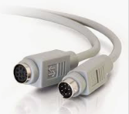
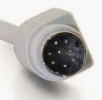
Networks
Wired Network LAN
Originally we used serial cable , but Alexander Graham Bell invented Twisted cables so we could move to Ethernet cabling.
But in the old days I
used twisted pair using
a switch box.
Twisted pair
Using a BUS topology I connected 20 old Mac computers to a server.
How to connect several old computers
Peter Faulks About Networks. Slide 22

Slide 23
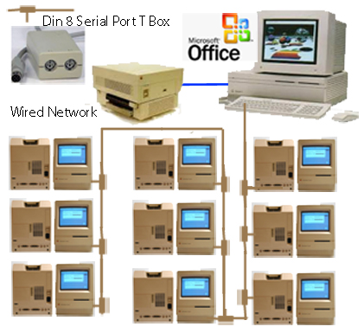
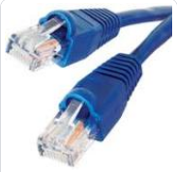
Networks
We were given old computers so I wired them into a network
Wired Network
Today we would use Ethernet IEEE 802.3 cable (twisted pair cable), rather than Serial cable
But we need a
Router
Because computers only
Have one Ethernet input
So unlike the network I built some years ago, we would use a router instead of serial port T boxes…
Each computer can use Office and sent work to a printer
Peter Faulks About Networks. Slide 23

Slide 24
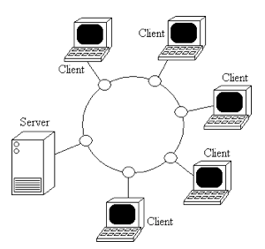
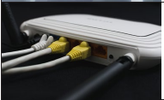
Networks
Modern Wired Network
Peter Faulks About Networks. Slide 24

Slide 25
A Wired network?
A Personal Area Network using only cables. (Printer,
USB cables, phone cable, )
Connected to a wire or system of wires, as an electronic device connecting computer systems or peripheral devices
Wired modem
Wired Printer
Keyboard
USB Flash drive
plug in to Hub
Mouse
Printer
Peter Faulks About Networks. Slide 25

Slide 26
Show a network using a Router and a server computer linking to three more computers
What is a router?
A router is a networking device that forwards data packets between computer networks. Routers perform the traffic directing functions on the Internet. Data sent through the internet, such as a web page or email, is in the form of data packets.
A router is a device that communicates between the internet and the devices in your home that connect to the internet. As its name implies, it “routes” traffic between the devices and
the internet. A router is a key part of your home’s internet network. Thanks to it,
your laptop, smartphone, smart TV, and other devices can connect
to your home Wi-Fi.
https://us.norton.com/internetsecurity-iot-smarter-home-what-is-router.html
Router with Ethernet
and other outlets
Ethernet hub with
multiple outlets
Router
To Printer
Peter Faulks About Networks. Slide 26

Slide 27
Ethernet Hub and Router
What is a Ethernet hub?
An Ethernet hub, active hub, network hub, repeater hub, multiport repeater,
or simply hub is a network hardware device for connecting multiple Ethernet
devices together and making them act as a single network segment.
A central switching point that all devices on an Ethernet segment plug into. Also known as a "multiport repeater" and sometimes called a "concentrator, the hub shares the total bandwidth among all users.
Ethernet hub with
multiple outlets
Ethernet cables are commonly used to connect to the hub
https://www.pcmag.com/encyclopedia/term/ethernet-hub
Peter Faulks About Networks. Slide 27

Slide 28
Networks
Ethernet
Advantages and disadvantages of Ethernet
Ethernet has many benefits for users, which is why it grew so popular. However, there are a few disadvantages as well.
Advantages of Ethernet
relatively low cost;
backward compatibility;
generally resistant to noise;
good data transfer quality;
speed; can go up to 400Gigabits per Second (Gbps)
reliability; and data security, as common firewalls can be used.
Disadvantages of Ethernet
intended for smaller, shorter distance networks;
limited mobility;
use of longer cables can create crosstalk;
doesn't work well with real-time or interactive applications;
speeds decrease with increased traffic;
receivers don't acknowledge the reception of data packets; and
troubleshooting is hard when trying to trace which specific cable or node is causing the issue.
https://www.techtarget.com/searchnetworking/definition/Ethernet
Peter Faulks About Networks. Slide 28

Slide 29
Speed the internet is brought into you home
Any type of computer network that uses wireless data connections for connecting networks but they can be connected to an Internet Service Provider
And the country Network system
An Internet service provider (ISP) sells wi-fi to your home, what
influences cost of this service, (Speed) 50mbs is a reasonable speed
for downloading then we see upload speed (usually less required)
Speed for streaming movies, > 40Mbs (MegaBits per second)
speed for transferring files or images> 20 Mbs
Peter Faulks About Networks. Slide 29

Slide 30
Networks
We were given old computers so I wired them into a network
Wired Network
Problem was the mouse rolled on four wheels using a rubber ball which the students would steal so we had to issued a mouse on presentation of a student card, we had to clean the inside every few days
Each computer can use Office and sent work to a printer
https://www.businessinsider.com/apple-mouse-through-the-years-2011-8#before-we-get-to-apples-mouse-heres-the-first-mouse-ever-from-1963-1
Peter Faulks About Networks. Slide 30

Slide 31
What is a Mobile network?
A system of connecting movable computer systems or peripheral devices, each one remote from the others.
A mobile phone network or cellular phone network as it is also known, is made up of a large number of signal areas called cells. These cells join or overlap each other to form a large coverage area. Users on the network can cross into different cells without loosing connection.
Within each cell you will find a base station or mobile phone tower, which sends and receives the mobile transmissions. A mobile device will connect to the nearest or least congested base station. The base stations are connected to a digital exchange where the communication is sent to other telephone or data networks.
Cells will often be smaller in size throughout large towns and cities due to the number of users in the area. The higher the population density the more base stations are needed.
https://mobilenetworkguide.com.au/mobile_phone_networks.html
Peter Faulks About Networks. Slide 31

Slide 32
Network hardware – what is a modem?
What is a Modem?
A modem is a box that connects your home network to your internet service provider, or ISP. A router is a box that lets all of your wired and wireless devices use that internet connection at once and allows them to talk to one another directly.
It’s an electronic device used to access the Internet that modulates carrier waves to encode information to be transmitted and also demodulates incoming carrier waves to decode the information they carry. A modem is device that can convert digital data transmitted over WIFI or cables into a form that your computer can use/interpret.
Modem is short for Modulator Demodulator
Changes signal types digital to analog.
Peter Faulks About Networks. Slide 32

Slide 33
Network hardware – what is a router?
Network hardware – what is a router?
What is a router?
A router is a networking device that forwards data packets between computer networks. Routers perform the traffic directing functions on the Internet. Data sent through the internet, such as a web page or email, is in the form of data packets.
A router is a device that communicates between the internet and the devices in your home that connect to the internet. As its name implies, it “routes” traffic between the devices and the internet.
A router is a key part of your home’s internet network. Thanks to it,
your laptop, smartphone, smart TV, and other devices can connect to your home Wi-Fi.
https://us.norton.com/internetsecurity-iot-smarter-home-what-is-router.html
Peter Faulks About Networks. Slide 33

Slide 34
Network hardware – what is a hub?
What is a hub?
A hub is the connection point in a computer device where data from many directions converge and are then sent out in many directions to respective devices.
A hub may also act as a switch by preventing specific data packets from proceeding to a destination.
https://www.techopedia.com/definition/3167/hub
Peter Faulks About Networks. Slide 34

Slide 35
Network hardware – what is a switch?
Network hardware – what is a switch?
Switches facilitate the sharing of resources by connecting together all the devices, including computers, printers, and servers, in a small business network.
Network Switch Units
The switch allows extra computers to connect to the network but only use up network space when they are on and release network space if not in use, rather than take up network space all the time on or off.
Thanks to the switch, these connected devices can share information and talk to each other, regardless of where they are in a building or on a campus. Building a small business network is not possible without switches to tie devices together, and save on Network speed.
https://www.cisco.com/c/en/us/solutions/small-business/resource-center/networking/network-switch-vs-router.html
Peter Faulks About Networks. Slide 35

Slide 36
Network hardware – what is a bridge?
Network hardware – what is a bridge?
A bridge is a type of computer network device that provides interconnection with other bridge networks that use the same protocol. Bridge devices work at the data link layer of the Open System Interconnect (OSI) model, connecting two different networks together and providing communication between them.
One of the physical properties of an Ethernet is that all computers share the same electric wire. Therefore computers compete to have access of the wire for communicating. If two computers attempt to transmit data at the same time a collision event occurs and the computers keep vying for control of the Ethernet until one wins out.
A network bridge is a device that divides a network into segments. Each segment represent a separate collision domain, so the number of collisions on the network is reduced. Also, because each collision domain has its own separate bandwidth, a bridge also improves the overall network performance.
Peter Faulks About Networks. Slide 36

Slide 37
Other Network Topologies
Peter Faulks About Networks. Slide 37

Slide 38
Other Network Topologies
Bus topology, (Older network topology) also known as line topology,
A bus topology exists when all the nodes on the network are connected to a single cable. This single cable is commonly referred to as a backbone. Bus topology was used for early 10Base-2, ThinNet, and 10Base-5, ThickNet, coaxial cable Ethernet networks. In this topology messages sent from a node are broadcast to all nodes on the network. Only the intended recipient node accepts and processes the message. This type of network topology is relatively easy to install and inexpensive. This topology requires that both ends of the backbone cable be terminated. If the backbone is not terminated, then the signal is likely to bounce back from the end of the cable causing data collisions and noise that may disrupt the network. The main drawbacks to this type of network topology are a limitation on the number of computers that can be connected to the network, and the fact that only a single backbone cable is used to connect all of the nodes. Networks using a bus topology are limited to only a few dozen computers. If the network exceeds this size performance, problems will likely result. If there is a failure in the
backbone cable connecting all of the nodes, then the
entire network will become unstable and potentially
cease to function. This topology is not typically used in
modern networks.
Peter Faulks About Networks. Slide 38

Slide 39
Other Network Topologies
Star topology is a network topology in which each network component is physically connected to a central node such as a router
The star and extended star are the most popular topologies for Ethernet networks. This type of network is easy to setup, relatively inexpensive, and provides more redundancy than other topologies, i.e. bus topology. The star topology is configured by connecting all the nodes on the network to a central device. The central connection allows the network to continue functioning even if a single node or cable fails. The major drawback to this topology is that if the central device fails, then the network will become unstable or cease to function. The star topology is most suitable for small, centralized networks. The extended star topology adds sub-central devices that are connected to the central device. This type of topology is advantageous for large networks and provides functionality for the organization and subnetting of the IP address allocation within the network. The extended star topology is most suitable for large networks that may span an entire building.
Peter Faulks About Networks. Slide 39

Slide 40
Other Network Topologies
The tree/hierarchical topology
The tree/hierarchical topology is configured by integrating multiple star topologies on a bus topology and using a central "root" node. The major drawback to this topology is that if the "root" node fails, then the network will become unstable or cease to function. This type of topology holds the advantage over a bus or star topology because it can better support future expansion of the network. However, this type of network is not commonly used because of the vulnerability of the topology.
Peter Faulks About Networks. Slide 40

Slide 41
Other Network Topologies
Ring topology is a type of network topology in which each device is connected to two other devices on either side via an RJ-45 cable or coaxial cable.
A ring topology exists when all of the nodes on the network are connected in a circle. Each node in the network acts as a repeater keeping the signal strong as it travels through the network. A node will generate a signal that is addressed to a specific computer on the network, and then the signal will be sent through the network in either a clockwise or counterclockwise direction. It is important to note that all signals on a network using this type of topology must travel in the same direction. This reduces the amount of data collision and noise on the network.
The signal will continue through each node until it reaches the intended destination node. Typically, this type of network will use a Token Ring protocol, which allows only one computer to transmit a signal at any given time. The main drawback of this type of topology is that if there is a failure of any of the nodes or cables connecting the nodes, then the network will become unstable and potentially cease to function. The solution to this drawback is a double ring topology. The double ring adds a secondary cable for redundancy in the case of a failure.
Peter Faulks About Networks. Slide 41

Slide 42
Other Network Topologies
Bus topology, also known as line topology, is a type of network topology in which all devices in the network are connected by one central RJ-45 network
Ring topology is a type of network topology in which each device is connected to two other devices on either side via an RJ-45 cable or coaxial cable.
Star topology is a network topology in which each network component is physically connected to a central node such as a router
Peter Faulks About Networks. Slide 42

Slide 43
Other Network Topologies
Mesh topology
This topology is divided into two different types: full-mesh and partial mesh. A full mesh topology provides a connection from each node to every other node on the network. This provides a fully redundant network and is the most reliable of all networks. If any link or node in the network fails, then there will be another path that will allow network traffic to continue. The major drawback to this type of network is the expense and complexity required to configure this topology. This type of topology is only used in small networks with only a few nodes. A partial mesh topology provides alternate routes from each node to some of the other nodes on the network. This type of topology provides some redundancy and is commonly used in backbone environments, networks where services are vital, and in wide area networks, WANs. The most notable partial mesh network is the Internet.
https://www.cablestogo.com/learning/library/data-center/network-topologies
Peter Faulks About Networks. Slide 43

Slide 44
Other Network Topologies
Hybrid topology
A hybrid topology is a type of network topology that uses two or more differing network topologies
https://www.cablestogo.com/learning/library/data-center/network-topologies
Peter Faulks About Networks. Slide 44

Slide 45
References
Ursula Frayne Catholic College Year 7 Digital Technologies
1
Produced by Peter J Faulks
I declare this work is my own signed
Help Page
Wired Network https://www.omnisecu.com/basic-networking/why-we-need-computer-network.php
LAN (Local Area Network) https://www.javatpoint.com/types-of-computer-network
Networks https://www.google.com/search?client=firefox-b-e&q=network+nodes%00
https://theapplemuseum.org/html/main/x-mac-128k.html
Network Types https://www.computerhope.com/jargon/n/network.htm
WAN (Wide Area Network) https://www.computerhope.com/jargon/n/network.htm
Why Do We Use Networks https://data-flair.training/blogs/types-of-computer-networks/
Advantages of Network https://data-flair.training/blogs/types-of-computer-networks/
PAN (Personal Area Network) https://www.computerhope.com/jargon/n/network.htm
MAN (Metropolitan Area Network)
Disadvantages of Networks
Ethernet https://www.techtarget.com/searchnetworking/definition/Ethernet
https://www.techtarget.com/searchnetworking/definition/Ethernet
Wired Networks
Images
My Screen Template
Peter Faulks About Networks. Slide 45

